Slide 1
DHS Battle Insider Threats and Maintain National Cyber Security
Final Presentation
10/12/2018 - 10/14/2018
Group 2
Gaurav Sharma
Preeti Preeti
Sai Kiran Kumar Rayanapati
V M Naveen Chatlapalli

Slide 2
Table of Content
Introduction (Challenges & Solutions)
Solving the challenge of Unifying components
Reducing the number of data centers and strengthen the components
FDCC Standards for the compliance regulations
Solving the administrative changes in the Systems
Future of Cyber Security

Slide 3
Introduction
Challenges
Solutions
Unifying 21 component agencies
One secure network and reduce the number of data centers
Compliance regulations with FDCC Standards
Tracking and logging all administrative changes to its system
Explaining the tools to achieve
Azure as an example of secure network
Discussing in-depth of FDCC Standards
Implementing the smart contracts in Blockchain for giving the expected results

Slide 5
Solving the challenge of unifying 21 component agencies
SSO – Single Sign On for much better UX(User Experience) & Control
To unify the access channels for each component agency
Centralized access control for each component agency
Individually one SSO server dedicated(integrated with AD/LDAP) for each component agency
Seamless integration of all apps under single component agency
SSO Hardening
SSO with MFA (multi factor authentication) for more restricted access to agency restricted assets
SSO with Digital Certificate with MFA for confidential assets
SSO with MFA(Biometric verification) for highly confidential assets

Slide 6
Okta - SSO & IAM solutions
Secured Active Directory (AD/LDAP) integration
Real time security analysis and reporting dashboards
Adaptive authentication escalations based on configurable policies
Location Context
New location?
Device Context
New Device?
Network Context
New network address?
MFA includes OTP, Soft-Token, OKTA push tokens, Hard-Tokens, Biometric verifications
Most popular in the industry

Slide 7
Secure network tools and implementing cloud infrastructure to reduce the number of data centers
Logical Weapons
Reconnaissance Tools
CheckUserNames
Unicornscan
Nmap
Scanning Tools
Peekyou
Lullar
SAMRi10
Reporting & Auditing tools
Reporting service on Cloud based solutions

Slide 8
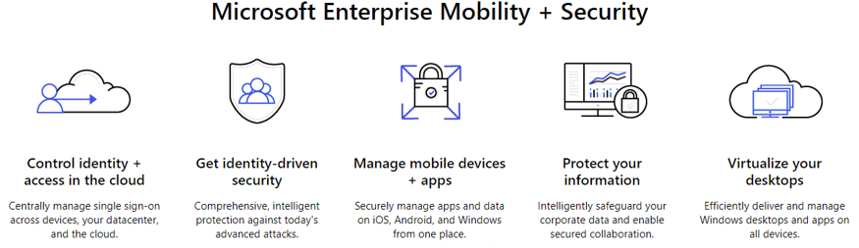
Cloud Enterprise Mobility Tool
Source: Retrieved from https://www.microsoft.com/azure-cybersecurity-applications/

Slide 9
Compliance regulations including FDCC standards.
What is FDCC?
Goal of FDCC?
Roles of SCAP in FDCC?
What is USGCB?

Slide 10
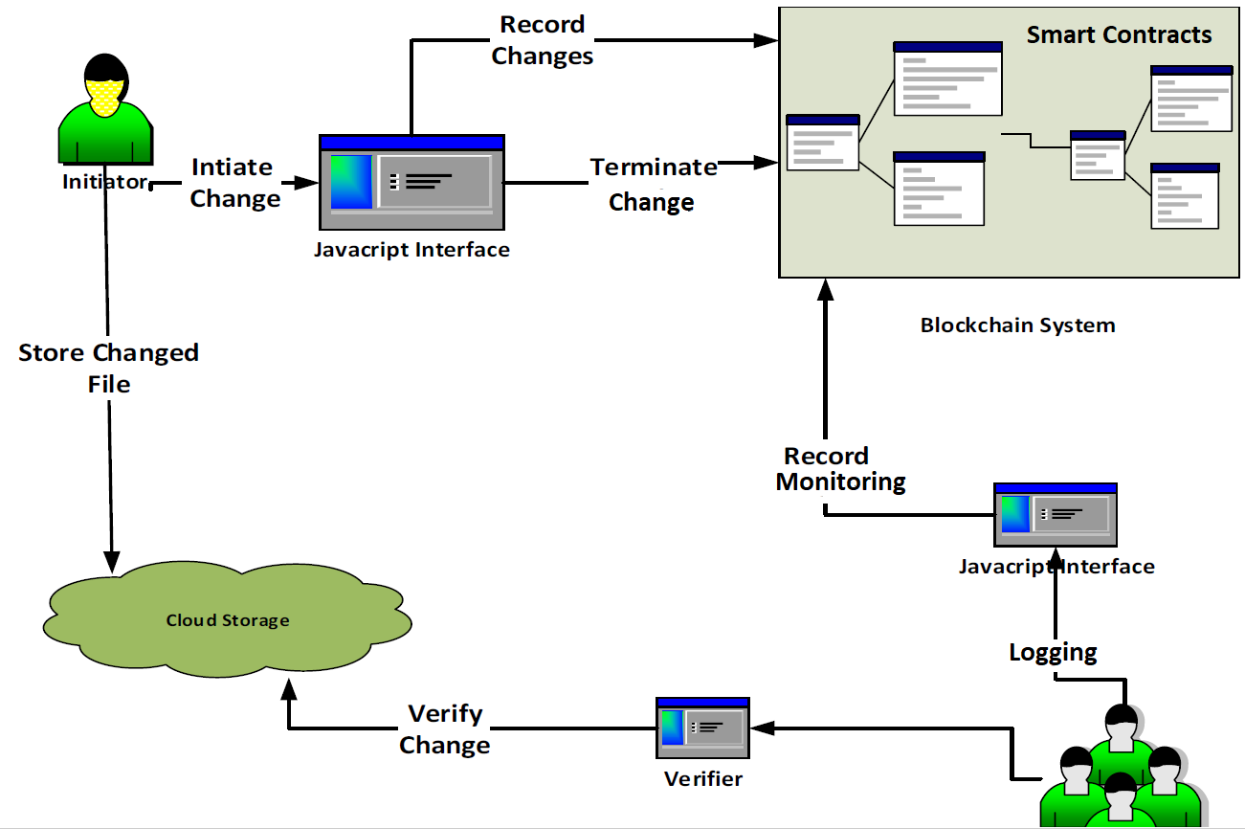
Solving the access and monitoring, logging and tracking all administrative changes to its systems using Blockchain
Source [1709.10000v1] Using Blockchain and smart contracts

Slide 11
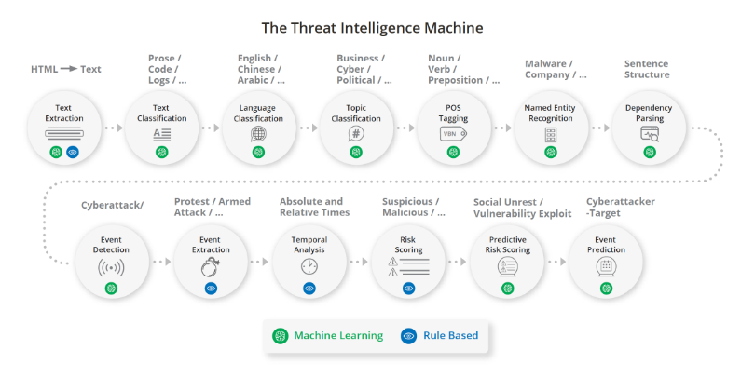
Future of Cyber Security
Source: Machine Learning: Practical Applications for Cybersecurity. (2018, March 14). Retrieved from https://www.recordedfuture.com/machine-learning-cybersecurity-applications/

Slide 13
Summary
DHS Battle Insider Threats and Maintaining the National Cyber Security
Clearly explained unifying components and tools used
Strategies to secure network and reduce the data centers
Explained FDCC Standards for compliance regulations
Advised the smart contracts in blockchain for logging and tracking admin tools
Future of cyber security

Slide 14
References
ShieldX Networks. (n.d.). Retrieved from https://www.shieldx.com/wp-content/uploads/2018/02/ShieldX_White_Paper-Machine_Learning_for_Micro-Segmentation-WEB_0202
[1709.10000v1] Using Blockchain and smart contracts for secure data provenance management. (n.d.). Retrieved from https://arxiv.org/abs/1709.10000v1
IAM (Identity and Access Management). (n.d). Retrieved from https://www.okta.com/iam-identity-and-access-management/
Adaptive Multi-Factor Authentication - New Q2 FY19. (n.d). Retrieved from https://www.okta.com/products/adaptive-multi-factor-authentication/
Andress, J., & Winterfeld, S. (2014). Cyber Warfare : Techniques, Tactics and Tools for Security Practitioners (Vol. Second edition). Waltham, Massachusetts: Syngress. Retrieved from
Video Sources:
https://interset.com/videos/GuidetoDeeplearning
https://www.youtube.com/watch?v=BSCafDlyzbI

Slide 15

“https://github.com/navdatascience/DHS-Cyber-Security-Policy”
One single vulnerability is all an attacker needs!
Window Snyder
Chief Security Officer
(Intel)

Slide 16
THANK YOU!!!
ANY QUESTIONS?

